Slide 1
Stage 6, Bay 7 Stu’s Night-Mare Course Designer: Stu Wilson
Stu’s Night-Mare is a 12 round unlimited course. There are 4 steel plates with light-flashers to indicate neutralized. The start signal is audible.
The Handgun start position is standing behind fault line. Handgun loaded and holstered. If you do not have a holster, the pistol will be loaded and placed on barrel the corresponding barrel. The PCC start position is standing behind fault line. PCC loaded, safety on, stock touching belt.
On the audible start signal, engage each target until flasher flashes. Then, perform a mandatory reload and re-engage each target using strong hand until flasher flashes. Then, perform a mandatory reload and re-engage each target using weak hand until flasher flashes.

Slide 2
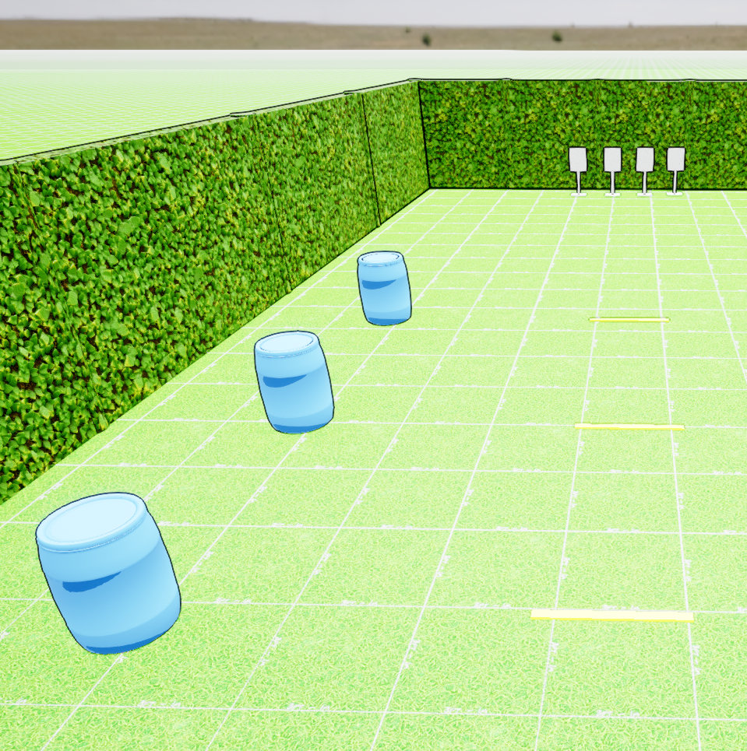
 | Stage 6, Bay 7 Stu’s Night-Mare Course Designer: Stu Wilson

